Slide 1
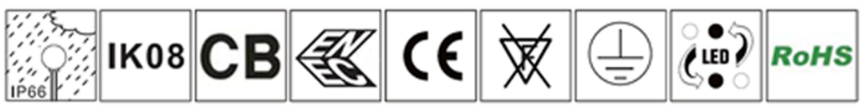
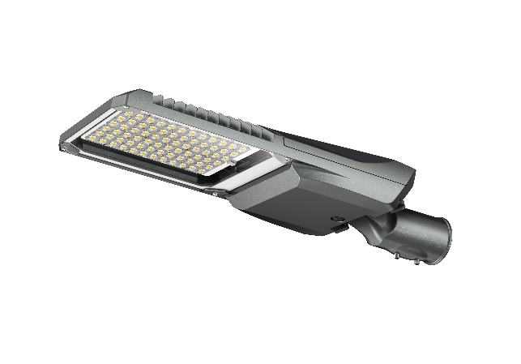
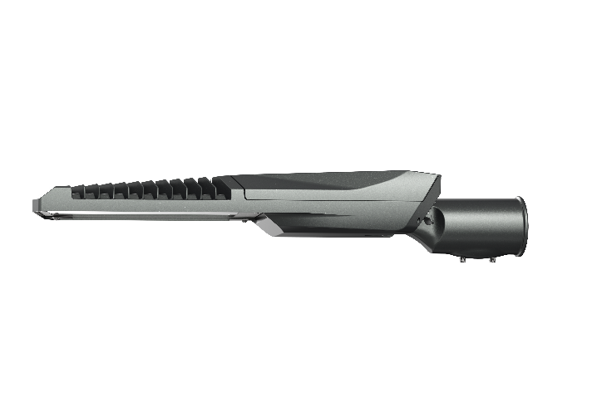
Mako Series
产品描述:
Standard Color: Dark Gray (PANTONE:8403C)
产品描述：
FEATURES:
产品特性:
Features:
Rated Power Range: 40W-240W;
Rated Input Voltage: AC100-277V;
Housing Material: Die-casting aluminum alloy+ temper glass
Luminary efficiency: 180lm/w
Cover opening: Up cover with tool free
Protection Degree: IP66, IK08;
Angle Adjuster: plus 15 ° to minus 15 ° angle adjustment for horizontal and vertical installation (5° angle adjustment);
NEMA interface is optional;
Control mode: Power line communication (NEMA),
Pole Diameter: Φ60mm
Operating environment: Operating Temperature - 40℃ ~ 50℃, Operating Humidity10% ~ 90 %RH, Storage Temperature -40 ℃ ~ 55 ℃.

Slide 2
Product Model | UNI-STF7-1-40 | UNI-STF7-1-60 | UNI-STF7-2-90 | UNI-STF7-2-100 | UNI-STF7-3-120 | UNI-STF7-3-150 | UNI-STF7-4-180 | UNI-STF7-4-200 | UNI-STF7-4-240
Power (W) | 40 | 60 | 90 | 100 | 120 | 150 | 180 | 200 | 240
Luminous Flux （lm） | 7200 | 10800 | 16200 | 18000 | 21600 | 27000 | 32400 | 36000 | 43200
LED Qty | 32 | 40 | 56 | 64 | 72 | 80 | 96 | 104 | 124
Power Factor | ≥0.92 | ≥0.95 | ≥0.95 | ≥0.95 | ≥0.95 | ≥0.95 | ≥0.95 | ≥0.95 | ≥0.95
Input Voltage | AC100-277V 50/60Hz
LED | Domestic/5050
Driver | Philips/Moso/Inventronics/Sosen
CCT（K） | 3000K/4000K/5000K/5700K/6500K
Luminaire Efficiency@4000K、Ta=25℃ (lm/W) | 180
CRI | 70
Working Temp. | - 40 ℃ ～45 ℃
Working Humidity | 10 % ～ 90 % RH
Storage Temp. | - 40 ℃ ～ 55 ℃
Housing Materials | Die-casting aluminum+ Whole PC lens+ Adjustble angle adaptor
IP Grade | IP66
IK Grade | IK08
Life Span (Hrs) | 100,000
Max Projected Area (㎡) | 0.09 | 0.09 | 0.11 | 0.11 | 0.14 | 0.14 | 0.16 | 0.16 | 0.16
Angle range | ﹣15°-- ﹢15°
Product Dimension (mm) | 495×200×104 | 495×200×104 | 595×212×104 | 595×212×104 | 605×270×104 | 605×270×104 | 667×270×104 | 667×270×104 | 667×270×104
Net Weight (kg) | 3.3±0.5KG | 3.3±0.5KG | 3.8±0.5KG | 3.8±0.5KG | 4.7±0.5KG | 4.7±0.5KG | 6.5±0.5KG | 6.5±0.5KG | 6.5±0.5KG
Gross Weight (kg)
Note: The tolerance of Luminous Flux for lighting products is ±7%

Slide 3
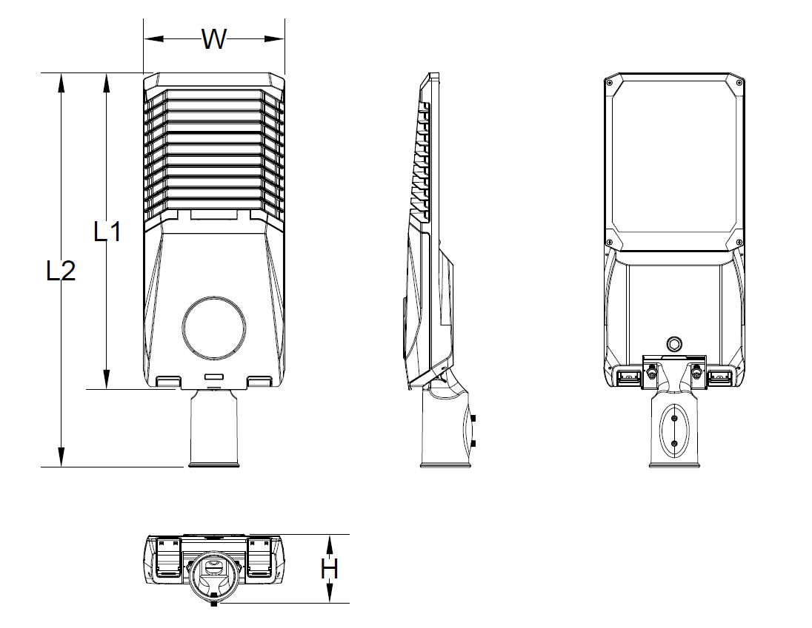
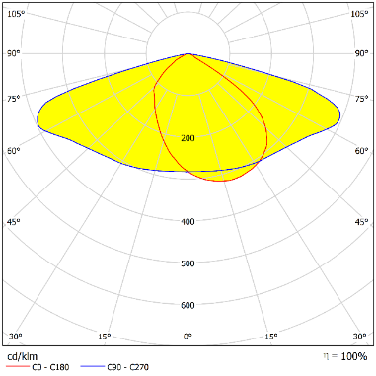
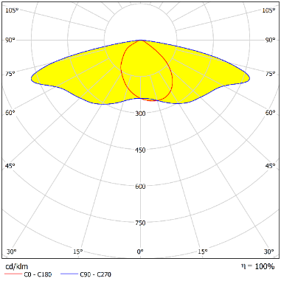
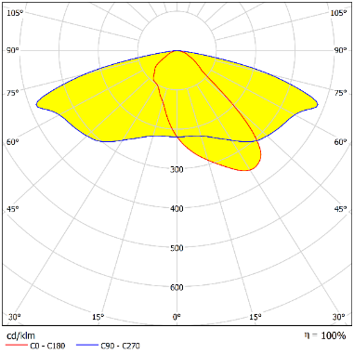
Product Dimension:
Model | Dimension（mm）
 | L1 | L2 | W | H
STF7-1 | 378 | 495 | 200 | 104
STF7-2 | 478 | 595 | 212 | 104
STF7-3 | 488 | 605 | 270 | 104
STF7-4 | 550 | 667 | 270 | 104
曲线配光：
Light Distributions:
618-00
710-00
830-00
Note: The pictures are only the references of typical light distribution type, and the specific parameters shall be subject to the actual IES of the product.

Slide 4

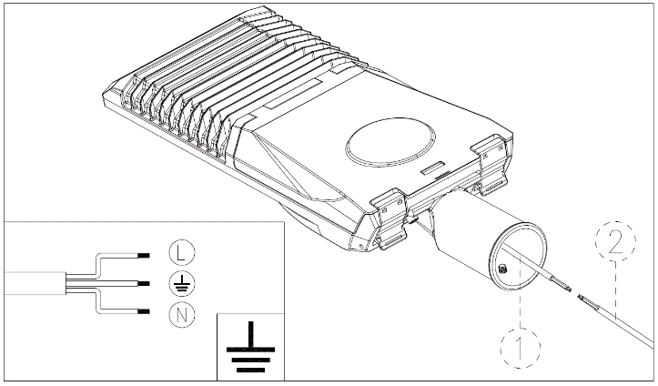
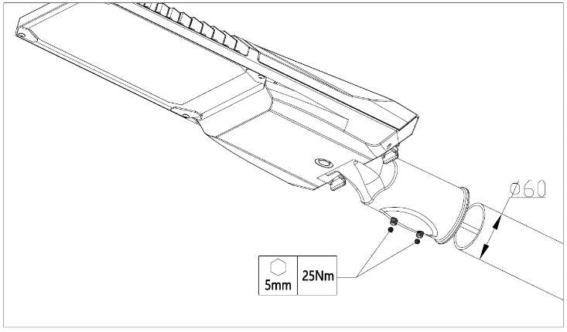
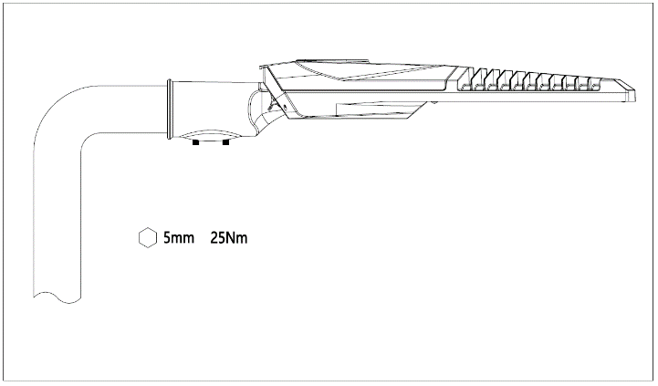
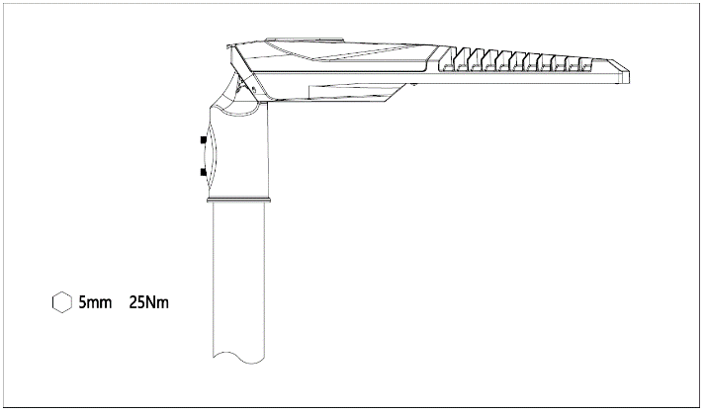
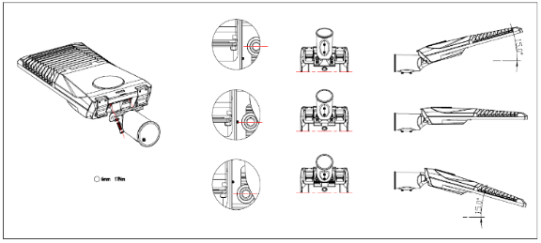
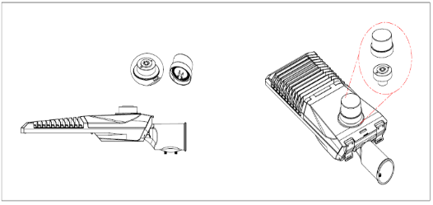
Installation Diagram:
吊杆安装示意图：
1. Wire the power cables of the luminaire and the pole according to the picture below: L(BRN) live line, N (BLU) neutral line,
(YG/GRN) ground line) , making the connection waterproof.
2. Insert the cantilevered arm of lamp pole into the lamp, and then tighten 2pcs M10 screws.
3. Loosen the two screws as shown in the picture; and align the notch of the angle adjuster with the center of the screw to achieve 0 °, and move one tooth up or down to adjust ± 5 °; Adjust to the desired angle and then tighten the two M8 screws.
4. Match NEMA interface

Slide 5


Maintenance:
Keep the luminaire in clean and good maintenance to ensure long lifespan and safety use.
Wipe the luminaire with soft cloth dipped with soapy water (squeeze the water out first), and then make it clean and dry with a new cloth;
Do not use volatile chemical liquids such as gasoline, alcohol or insecticides to clean the luminaire, otherwise damage occurs.
Cautions:
维护保养：
Make sure safe and complete installation before power on;
Do not mount the luminaire onto ordinary combustible materials directly in any circumstances;
Do not cover the luminaire with any objects;
Do not use the product in a closed environment;
The maintenance of the luminaire must be done by professionals;
The external wiring of the luminaire is Y-shaped. If damaged, shall be replaced with wires provided by the original manufacturer or its service team;
The light source, if damaged, shall be replaced with chips provided by the manufacturer or service team.
Warning, danger of electric shock
Statement: The luminaire complies with the non-hazardous requirements in the photobiological safety standard IEC 62471:2006;
Product specifications are subject to change without notice.
HQ Address: 112 Yongfu Rd., Qiaotou Village, Fuyong Town, Baoan District, Shenzhen 518103 China.
Manufacturing Base: Unilumin Industrial Park, 6th Lanjing North Road, Pingshan District, Shenzhen, China.
TEL：+86-0755-29918999
FAX：+86-0755-29912092
www.unilumin.com
www.unilumin-lighting.com

